Slide 1
Values and Attitudes

Slide 2
Values
Basic convictions that “a specific mode of conduct or end state of existence is personally or socially preferable to an opposite or converse mode of conduct or end-state”
“how to live your life that is personally or socially preferable”
Contain a “judgmental element”
Attributes of Values
Content Attribute – that the mode of conduct or end-state of existence is important
Intensity Attribute –how important that content is.
Value System
A person’s values rank ordered by intensity
Tends to be relatively constant and consistent

Slide 3
Difference between attitude and Values
Read The Following Statements Carefully:
Every one deserves the right to an education
Gaining an education is important
Being educated means that you have knowledge and understanding about the world

Slide 4
Every week day morning I jumped out of the besd and think………………”Yippee! School Again
I am always sad when it is the end of the school
On Friday afternoons I feel miserable because there is no school for two days.

Slide 5
Are Values fluid and flexible?
Organizational Implications of values:
Lays the foundations for attitude and motivation
Provide understanding of the attitudes, motivation, perception and behaviors
Influence our perception of the world around us
Represent interpretations of “right” and “wrong”
Imply that some behaviors or outcomes are preferred over others

Slide 6
Types of Values
Terminal Values
Desirable end-states of existence; the goals that a person would like to achieve during his or her lifetime
Instrumental Values
Preferable modes of behavior or means of achieving one’s terminal values

Slide 7
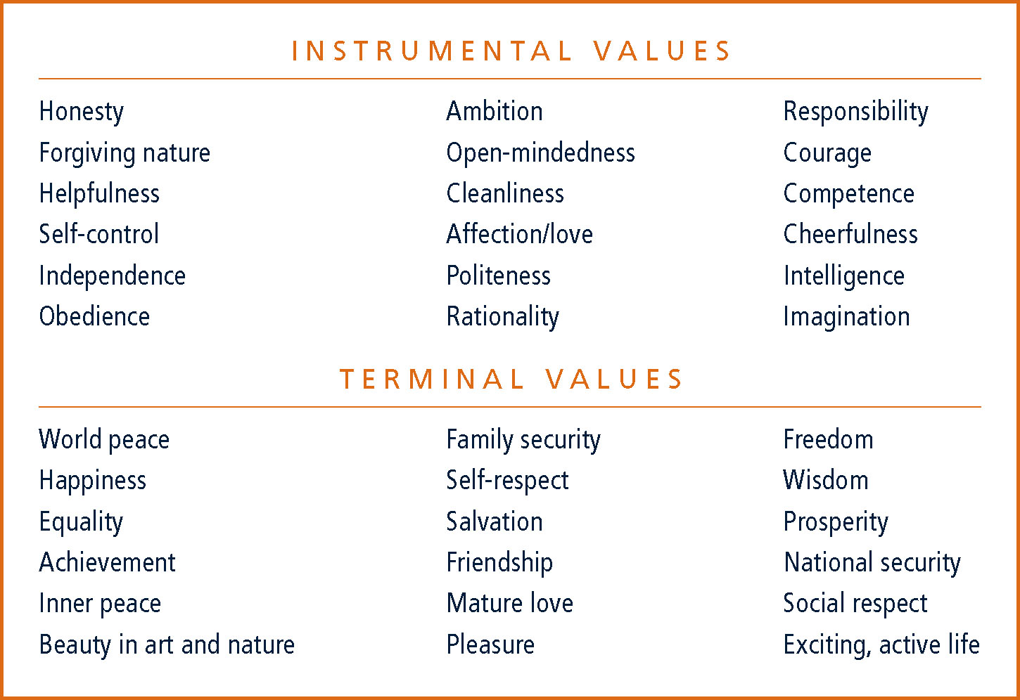

Slide 8
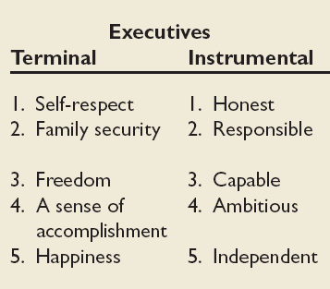
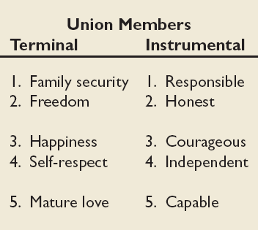
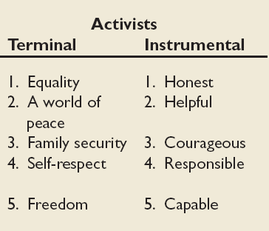
Value Differences Between Groups
People in same occupations or categories tend to hold similar values
But values vary between groups
Value differences make it difficult for groups to negotiate and may create conflict

Slide 9
Generational Values
Cohort | Entered Workforce | Approximate Current Age | Dominant Work Values
Veterans | 1950-1964 | 65+ | Hard working, conservative, conforming; loyalty to the organization
Boomers | 1965-1985 | 40-60s | Success, achievement, ambition, dislike of authority; loyalty to career
Xers | 1985-2000 | 20-40s | Work/life balance, team-oriented, dislike of rules; loyalty to relationships
Nexters | 2000-Present | Under 30 | Confident, financial success, self-reliant but team-oriented; loyalty to both self and relationships

Slide 10
Global Implications
Values differ across cultures.
Hofstede’s Framework for assessing culture – five value dimensions:
Power Distance
Individualism vs. Collectivism
Masculinity vs. Femininity
Uncertainty Avoidance
Long-term vs. Short-term Orientation

Slide 11
Hofstede’s Framework: Power Distance
The extent to which a society accepts that power in intuitions and organizations is distributed unequally
Low distance
Relatively equal power between those with status/wealth and those without status/wealth
High distance
Extremely unequal power distribution between those with status/wealth and those without status/wealth

Slide 12
Individualism vs Collectivism
Individualism
The degree to which people prefer to act as individuals rather than a member of groups
Collectivism
A tight social framework in which people expect others in groups of which they are a part to look after them and protect them

Slide 13
Quantity of life vs. Quality of life
Quantity of life
The extent to which the society values
Achievement
Power
Control
Assertiveness
Competition
Acquisition of money and material goods
Quality of life
The extent to which the society values
Relationship
Sensitivity
Concern for others

Slide 14
Uncertainty Avoidance
People in a country prefer structured over unstructured situations
The extent to which a society feels threatened by uncertain and ambiguous situations and tries to avoid them
High Uncertainty Avoidance:
Society does not like ambiguous situations and tries to avoid them.
Low Uncertainty Avoidance:
Society does not mind ambiguous situations and embraces them.

Slide 15
LTO vs. STO
Long-term Orientation
A national culture attribute that emphasizes the future, thrift, and persistence
Short-term Orientation
A national culture attribute that emphasizes the present and the here and now

Slide 16
Implications of Values
Determines Organizational Culture
Kaufman (2002): A positive organizational culture reinforces the core beliefs and behaviors that a leader desires while weakening the values and actions the leader rejects
Strong culture vs. Weak culture:
Strong Culture: is said to exist where staff respond to stimulus because of their alignment to organizational values.
Weak Culture: Where there is little alignment with organizational values and control must be exercised through extensive procedures and bureaucracy

Slide 17
Attitude
Stable evaluative tendency to respond consistently to some specific object, situation, person, or category of people
Attitudes are tendencies to respond to the target of the attitude
Attitudes often influence our behaviour toward some object, situation, person, or group.
Attitudes are a function of what we think and what we feel
Belief + Value = Attitude > Behaviour

Slide 18
Components of Attitude
Affective
Cognitive
Behavioral
Attitude
The emotional or feeling segment of an attitude
The opinion or belief segment of an attitude
An intention to behave in a certain way toward someone or something
.

Slide 19
Does Behavior Always Follow from Attitudes?
Leon Festinger – No, the reverse is sometimes true!
Cognitive Dissonance: Any incompatibility between two or more attitudes or between behavior and attitudes
Individuals seek to reduce this uncomfortable gap, or dissonance, to reach stability and consistency
Consistency is achieved by changing the attitudes, modifying the behaviors, or through rationalization
Desire to reduce dissonance depends on:
Importance of elements
Degree of individual influence
Rewards involved in dissonance

Slide 20
Predicting Behavior from Attitudes
Important attitudes have a strong relationship to behavior.
The closer the match between attitude and behavior, the stronger the relationship:
Specific attitudes predict specific behavior
General attitudes predict general behavior
The more frequently expressed an attitude, the better predictor it is.
High social pressures reduce the relationship and may cause dissonance.
Attitudes based on personal experience are stronger predictors.

Slide 21
What are the Major Job Attitudes?
Job Satisfaction
A positive feeling about the job resulting from an evaluation of its characteristics
Job Involvement
Degree of psychological identification with the job where perceived performance is important to self-worth
Psychological Empowerment
Belief in the degree of influence over the job, competence, job meaningfulness, and autonomy

Slide 22
Organizational Commitment
Identifying with a particular organization and its goals, while wishing to maintain membership in the organization.
Three dimensions:
Affective – emotional attachment to organization
Continuance Commitment – economic value of staying
Normative - moral or ethical obligations
Has some relation to performance, especially for new employees.
Less important now than in past – now perhaps more of occupational commitment, loyalty to profession rather than a given employer.

Slide 23
Perceived Organizational Support (POS)
Degree to which employees believe the organization values their contribution and cares about their well-being.
Higher when rewards are fair, employees are involved in decision-making, and supervisors are seen as supportive.
High POS is related to higher OCBs and performance.
Employee Engagement
The degree of involvement with, satisfaction with, and enthusiasm for the job.
Engaged employees are passionate about their work and company.

Slide 24
Job Satisfaction/ Dissatisfaction
Causes
Job Characteristics: Most popular measure of job satisfaction assesses how employees feel about their jobs along five dimensions (Smith, Kendall, & Hulin, 1969).
The type of work itself
Pay
Promotional opportunities
Supervision
Co-workers
Social Comparison
Disposition
Correlates
Performance
Absenteeism
Turnover

Slide 25
Pay influences job satisfaction only to a point.
After about $40,000 a year (in the U. S.), there is no relationship between amount of pay and job satisfaction.
Money may bring happiness, but not necessarily job satisfaction.
Personality can influence job satisfaction.
Negative people are usually not satisfied with their jobs.
Those with positive core self-evaluation are more satisfied with their jobs.

Slide 26
Employee Responses to Dissatisfaction
Active
Exit
Neglect
Loyalty
Voice
Behavior directed toward leaving the organization
Active and constructive attempts to improve conditions
Allowing conditions to worsen
Passively waiting for conditions to improve
Destructive
Constructive
Passive

Slide 27
Outcomes of Job Satisfaction
Job Performance
Satisfied workers are more productive AND more productive workers are more satisfied!
The causality may run both ways.
Organizational Citizenship Behaviors
Satisfaction influences OCB through perceptions of fairness.
Customer Satisfaction
Satisfied frontline employees increase customer satisfaction and loyalty.
Absenteeism
Satisfied employees are moderately less likely to miss work.

Slide 28
Turnover
Satisfied employees are less likely to quit.
Many moderating variables in this relationship.
Economic environment and tenure
Organizational actions taken to retain high performers and to weed out lower performers
Workplace Deviance
Dissatisfied workers are more likely to unionize, abuse substances, steal, be tardy, and withdraw.

